Slide 1
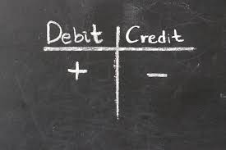

Rules of Accounting
Accounting Cycle & Rules of Accounting

Slide 2

Ne US, China reach audit deal allowing regulators to vet accounting firms ws-Sectoral Change
US regulators long demanded access to audit papers of Chinese companies listed in the US, but Beijing has been reluctant to let overseas regulators inspect accounting firms, citing security concerns.
Notes:
https://www.business-standard.com/article/international/us-china-reach-audit-deal-allowing-regulators-to-vet-accounting-firms-122082601443_1.html

Slide 3


Learning Outcomes
.
Apply the accounting rules in recording the business transactions.

Slide 4
POLL
Which of the following is not a step of accounting cycle?
Identifying the transactions
Adjust Trial balance
Closing books of accounts
Reconciling the leger
Notes:
D

Slide 5
Rules of Debit and Credit-Why???
Recording of business transactions in Books of Accounts in a systematic manner.

Slide 6

What is Debit and Credit???
Debits and credits are simply additions to or subtractions from an account.
"Dr." used in journal entries to refer to debits and "Cr." used in journal entries for a credit.

Slide 7
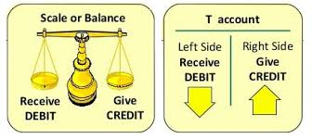
Asset, Expense and Loss accounts normally have debit balances; liability, income and capital accounts normally have credit balances.

Slide 8
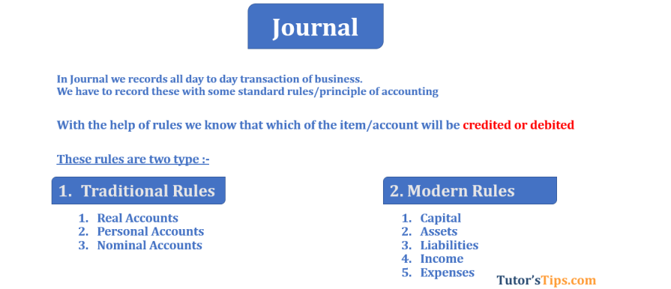

Slide 9
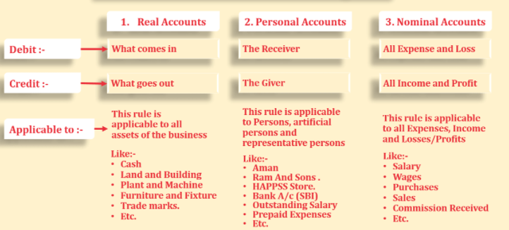
Traditional Rules of Debit and Credit

Slide 10
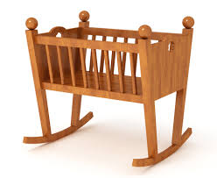

Memorize the word (CRADLE)
C – Capital
R – Revenue
A – Assets
D – Drawings
L – Liability
E – Expense

Slide 11
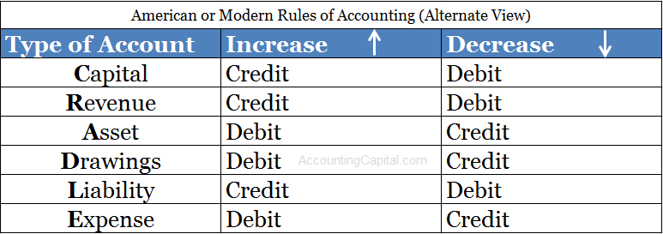

Slide 12
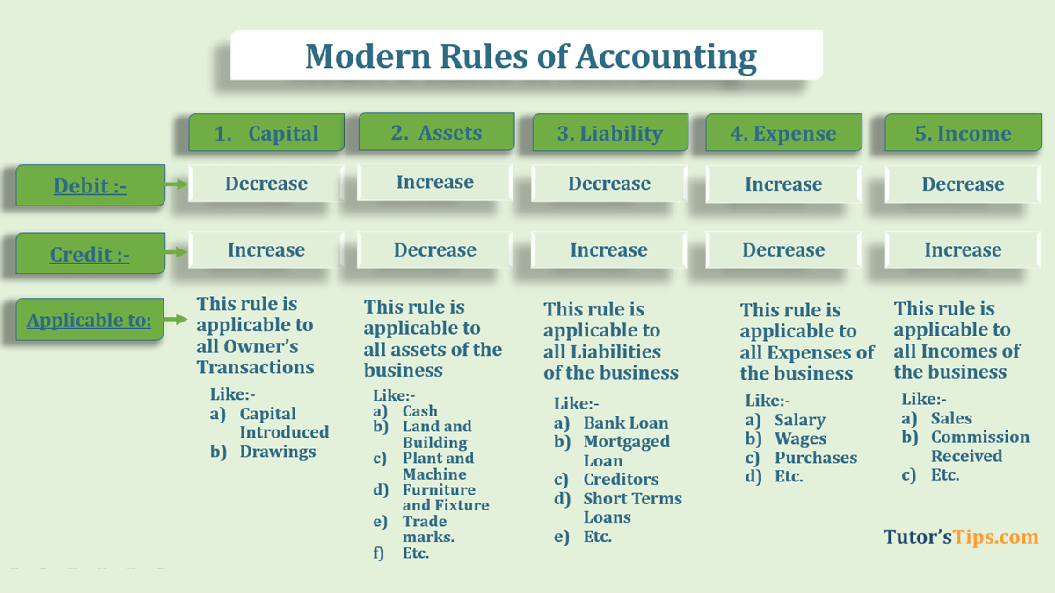

Slide 13
Debit or Credit-Steps to be followed
Identify the business transactions.
Find out the accounts involved in each transaction.
Specify category of accounts out of five categories i.e. Asset, Liability, Capital, Revenue and Income.
Mention the increase or decrease in the accounts as per the transaction given in question.
Apply the modern rules of accounting on each account and mention the debit or credit accordingly.

Slide 14
Example
Q1: ABC Ltd. sold goods to Mr. Balram for Rs. 6,0000 on credit.
Steps: 1. Sold goods on credit.
2. Accounts involved: (a) Sales Account (b) Debtor Account (Mr. Balram)
3. Sales Account belongs to Revenue category and Debtor Account belongs to Asset category
4. Revenue as well as Debtors both the accounts have been increased
5. As per modern rules of accounting, increase in Revenue is credited and increase in Asset is debited
So Asset (Balram) Account will be debited and Sales Account will be credited with amount of Rs.60000.

Slide 15
Example Journal Entries
Purchased furniture for 20,000 in cash
Accounts Involved | Amount | Rule Applied
 | 20,000
 | 20,000
Furniture A/C
Asset – Dr. the increase
To Cash A/C
Asset – Cr. the decrease

Slide 16
Example Journal Entries
Received 1,00,000 in the bank as a loan
Accounts Involved | Amount | Rule Applied
 | 1,00,000
 | 1,00,000
Bank A/C
Asset – Dr. the increase
To Loan A/C
Liability – Cr. the increase

Slide 17
Example Journal Entries
Received 5,00,000 via a cheque from Mr. Unreal as a trade receivable,
Accounts Involved | Amount | Rule Applied
 | 5,00,000
 | 5,00,000
Bank A/C
Asset – Dr. the increase
To Mr. Unreal A/C
Revenue – Cr. the increase

Slide 18
POLL
ABC Ltd. earned revenue of Rs.80,000. As per the modern rules of Debit and Credit, Revenue A/c of ABC Ltd. will be
Debited
Credited
Notes:
B

Slide 19
POLL
XYZ Ltd. received commission Rs. 4,000 from an agent. Which of the following two accounts are involved in this transaction?
A) Asset & Revenue
B) Revenue & Capital
C) Liability & Expense
D) Expense and Revenue
Notes:
A- Cash (Asset) and Commission (Revenue)

Slide 20
POLL
XYZ Ltd. received commission Rs. 4,000 from an agent. As per the modern rules of Dr. and Cr., which account will be debited and which one will be credited?
Dr. Cash, Cr. Commission with Rs.4000 each
Cr. Cash, Cr. Commission with Rs.2000 each
Dr. Cash, Dr. Commission with Rs.2000 each
Dr. Commission , Cr. Cash with Rs.4000 each
Notes:
A

Slide 21
POLL
Purchased Equipment for expansion of business on credit from Mr. Ram costing Rs 20,000. Which of the following two accounts are involved in this transaction?
A) Asset & Revenue
B) Revenue & Capital
C) Asset & Liability
D) Expense and Revenue
Notes:
C

Slide 22
POLL
Purchased Equipment for expansion of business on credit from Mr. Ram costing Rs 20,000. As per the modern rules of accounting, which account will be debited and which one will be credited?
Dr. Equipment A/c (Asset), Dr. Ram’s A/c (Creditor)
Dr. Ram’s A/c (Creditor) , Cr. Equipment A/c (Asset)
Dr. Equipment A/c (Asset), Cr. Ram’s A/c (Creditor)
Cr. Ram’s A/c (Creditor), Cr. Equipment A/c (Asset)
Notes:
C

Slide 23
POLL
Mr. Ajay invested Rs.1,00,000 in ABC Ltd. Which of the following two accounts are involved in this transaction?
A) Asset & Revenue
B) Revenue & Capital
C) Asset & Capital
D) Expense and Revenue
Notes:
C

Slide 24
POLL
Mr. Ajay invested Rs.1,00,000 in ABC Ltd.. As per the modern rules of accounting, which account will be debited and which one will be credited?
Dr. Capital A/c, Cr. Cash A/c
Cr. Capital A/c, Dr. Cash A/c
Dr. Capital A/c, Dr. Cash A/c
Cr. Capital A/c, Cr. Cash A/c
Notes:
B

Slide 25
POLL
Received 5,00,000 via a cheque from Mr. Unreal as a Trade receivable. As per the modern rules of accounting, which account will be debited and which one will be credited?
Dr. Bank A/c, Cr. Mr. Unreal A/c
Cr. Bank A/c, Dr. Mr. Unreal A/c
Dr. Bank A/c, Dr. Mr. Unreal A/c
Cr. Capital A/c, Cr. Cash A/c
Notes:
A.

Slide 26
POLL
Received 1,00,000 in the bank as a loan, As per the modern rules of accounting, which account will be debited and which one will be credited?
Dr. Bank A/c, Dr. Bank Loan A/c
Cr. Bank A/c, Dr. Bank Loan A/c
Dr. Bank A/c, Cr. Bank Loan A/c
Cr. Capital A/c, Cr. Bank Loan A/c
Notes:
C.

Slide 27
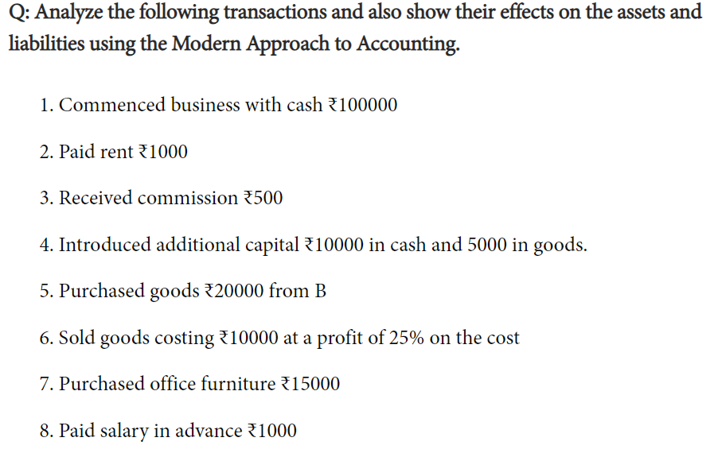
Home Work

Slide 28

Notes:
B

